Slide 1
Corporate Portfolio Analysis
Unit - IV

Slide 2
Introduction
Business Portfolio Analysis is a strategic management tool used to measure what product or service of the company excels or fails in its portfolio.
This helps a manager to appraise the market shares within the industry.
This business analysis portfolio allows organizations to learn their strength and weaknesses. By doing so, they enable customers to make rightful decisions regarding resource allocations.

Slide 3
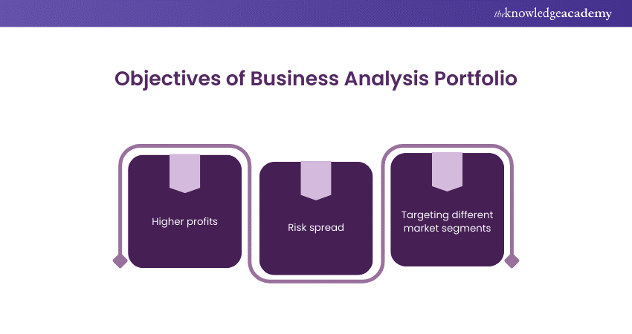

Slide 4
i. Higher Profits
maximizing profits through strategic resource allocation.
By identifying and nurturing high-performing products or services while divesting from underperformers, companies can amplify their overall profitability.
This targeted approach ensures that resources are channeled into ventures with the highest potential for returns, thereby enhancing the bottom line.

Slide 5
ii. Risk Spread
It empowers companies to diversify risk across a spectrum of products or services.
By maintaining a well-balanced portfolio comprising offerings in different stages of the product lifecycle, organizations can buffer themselves against market volatility.
This diversified approach minimizes the adverse impacts of unforeseen fluctuations, fostering resilience and stability in the face of uncertainty.

Slide 6
iii. Targeting Different Market Segments
A pivotal aspect of Business Portfolio Analysis lies in its capacity to facilitate tailored market targeting.
By meticulously examining the distinct needs and preferences of various customer segments, companies can craft offerings that resonate deeply with their intended audiences.
Through astute segmentation and positioning strategies, organizations can seize opportunities to capture market share and fuel revenue growth, thereby solidifying their competitive standing.

Slide 7
BCG Matrix
Boston Consulting Group is renowned as a thought leader in the management consulting world.
One of the firm’s most famous analytical frameworks includes the BCG Matrix, also known as the BCG Growth Share matrix.
The tool was first introduced in the 1970s by Bruce Henderson, the founder of BCG. It has continued to endure until the present day.

Slide 8
The BCG Matrix is used to help companies analyze their product portfolio by categorizing them into four distinct categories based on their market shares and growth rates relative to their largest competitors.
It is a framework for portfolio management that allows you to prioritize different products.
BCG matrix as a table that is divided into four parts, each of which represents a particular product or business, with a vertical axis that represents growth and a horizontal axis that represents market share.

Slide 9
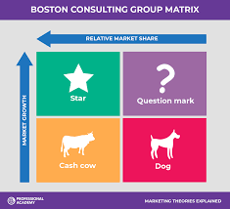
The vertical axis representing market growth is the amount of potential a product has to bring in money.
The horizontal axis representing market share is the portion of an area where you conduct commercial deals that you control.

Slide 10
Each category represents a particular type of product:
Stars are products that have a high growth rate and a high market share.
Question Marks are products that have a high growth rate but a low market share.
Dogs are products that have a low growth rate and a low market share.
Cash Cows are products that have a low growth rate but a high market share.

Slide 11
Stars
The Stars are business units with both high market share and a high growth industry.
They lead a niche or a market and have monopolistic qualities due to dominant competitive advantages or fortuitous timing.
As the stars continue to boom, additional investment generates excess cash, making stars extremely valuable products for a company.
The hope is that eventually as the industry growth rate dies down, the stars become cash cows.

Slide 12
Cash Cows
Cash Cows represents business units having a large market share in a mature, slow growing industry.
Cash cows require little investment and generate cash that can be utilized for investment in other business units.
These SBU’s are the corporation’s key source of cash, and are specifically the core business. They are the base of an organization. These businesses usually follow stability strategies.
When cash cows loose their appeal and move towards deterioration, then a retrenchment policy may be pursued.

Slide 13
Question Marks
Question marks represent business units having low relative market share and located in a high growth industry.
They require huge amount of cash to maintain or gain market share.
They require attention to determine if the venture can be viable.
Question marks are generally new goods and services which have a good commercial prospective.
There is no specific strategy which can be adopted.

Slide 14
If the firm thinks it has dominant market share, then it can adopt expansion strategy, else retrenchment strategy can be adopted.
Most businesses start as question marks as the company tries to enter a high growth market in which there is already a market-share.
If ignored, then question marks may become dogs, while if huge investment is made, then they have potential of becoming stars.

Slide 15
Dogs
Dogs represent businesses having weak market shares in low-growth markets.
They neither generate cash nor require huge amount of cash.
Due to low market share, these business units face cost disadvantages.
Generally retrenchment strategies are adopted because these firms can gain market share only at the expense of competitor’s/rival firms.

Slide 16
These business firms have weak market share because of high costs, poor quality, ineffective marketing, etc.
Unless a dog has some other strategic aim, it should be liquidated if there is fewer prospects for it to gain market share.
Number of dogs should be avoided and minimized in an organization.

Slide 17
Strategic Implications
Companies need to maintain its competitive position in the Cash Cows, but avoid overinvesting.
The surplus cash generated by Cash Cows should be invested first in Star businesses, if they are not self-sufficient, to maintain their relative competitive position.
Any surplus cash left with the organization may be used for selected Question Mark businesses to gain market share for them.
Those businesses with low market share, and which cannot adequately be funded, may be considered for divestment.
The Dogs are generally considered as the weak segments of the organization with limited or new investments allocated to them.

Slide 18
BCG Matrix Example: Apple
One of the most widely well known consumer product companies in the world is Apple. The company owns several product lines that can be categorized into different categories across the BCG Matrix. Here is a BCG Matrix example of how some of Apple’s products could be categorized using the matrix:
Cash Cow - Once an innovative product, Apple’s laptops are no longer in a fast-growing industry but generate healthy profits for the company
Dog - Apple’s iPods have now been cannibalized by its iPhones and should no longer receive further heavy investment
Question Mark - Apple’s AirPods are growing extremely quickly but have yet to dominate the market
Star - Apple’s iPhones continue to generate excess profits and the company dominates the growing smartphone market

Slide 19
Limitations of BCG Matrix
BCG matrix classifies businesses as low and high, but generally businesses can be medium also. Thus, the true nature of business may not be reflected.
Market is not clearly defined in this model.
High market share does not always leads to high profits. There are high costs also involved with high market share.
Growth rate and relative market share are not the only indicators of profitability. This model ignores and overlooks other indicators of profitability.
At times, dogs may help other businesses in gaining competitive advantage. They can earn even more than cash cows sometimes.
This four-celled approach is considered as to be too simplistic

Slide 20
Activity
Consider an organization with which you are familiar. Collect information regarding its various businesses and describe them using the BCG growth-share matrix. First give the chronology of year-wise business development and then the matrix.

Slide 21
General Electric (Mckinsey) Matrix
This matrix uses market attractiveness as not merely the growth rate of sales of the product, but a compound variable dependent on different factors influencing the future profitability of the business sector.
These different factors are either subjectively judged or objectively computed on the basis of certain weights, to arrive at the Market Attractiveness Index.
The Index is thus based on a thorough environmental assessment influencing the sectoral profitability.

Slide 22
Factors determining Industry Attractiveness:
Size of market
Rate of growth of sales and cyclic nature of business
Nature of competition including vulnerability to foreign competition
Susceptibility to technological obsolescence and new products
Entry conditions and social factors
Profitability
Socio/political risks
Seasonality
Cyclicality
Barriers to entry and exit

Slide 23
Factors determining Competitive Strengths
Relative market share
Distribution/brand strengths
Technology strengths
Innovation/management
Profit margins relative to competitors
Ability to compete on price and quality
Knowledge of customer and market
Caliber of management

Slide 24
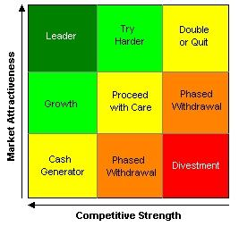

Slide 25
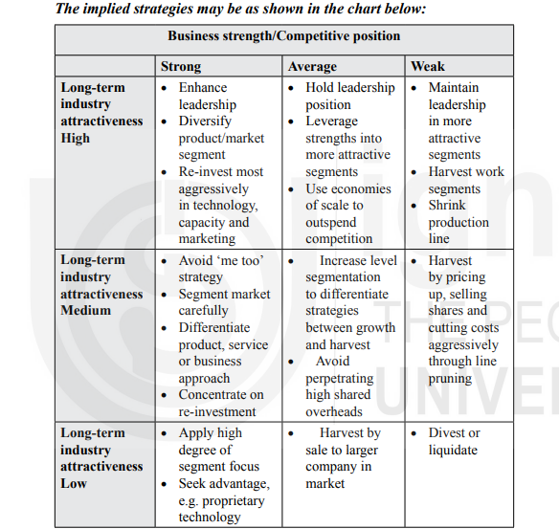

Slide 26
Strengths and Weaknesses of GE Matrix
There are strengths and weaknesses of this approach.
The use of multiple criteria provides sounder judgement.
The criteria used can be tailored to business level or business type and the matrix is relevant to many business situations.
However, the analysis is not totally quantitative and judgements need to be made.
To be effective the matrix needs sophisticated users.

